Slide 1
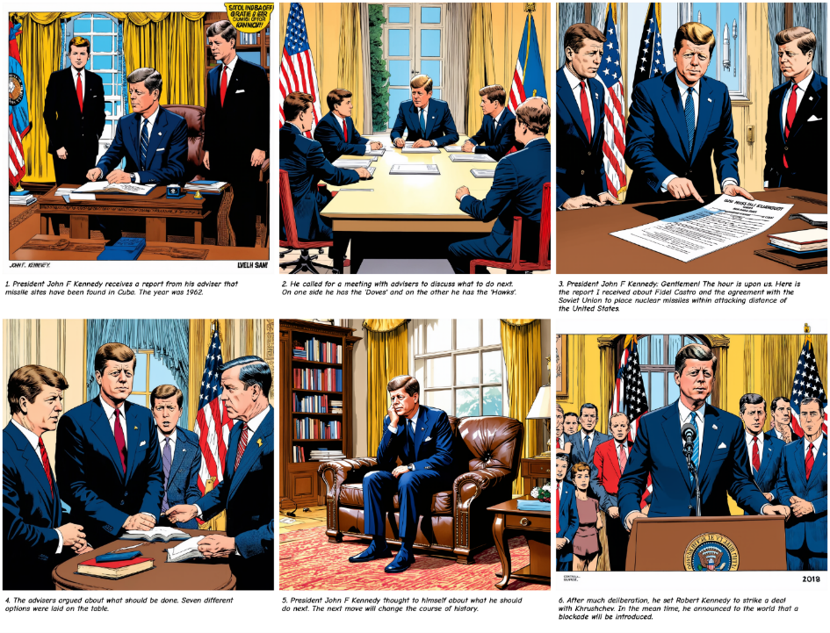
JFK
&
the Cuban
Missile
Crisis
User utilizes EduCreate’s curated content.
User Prompt: What was the sequence of events after President John F Kennedy was informed of the discovered missile sites in Cuba?
Comic Style: Golden Age

Slide 2
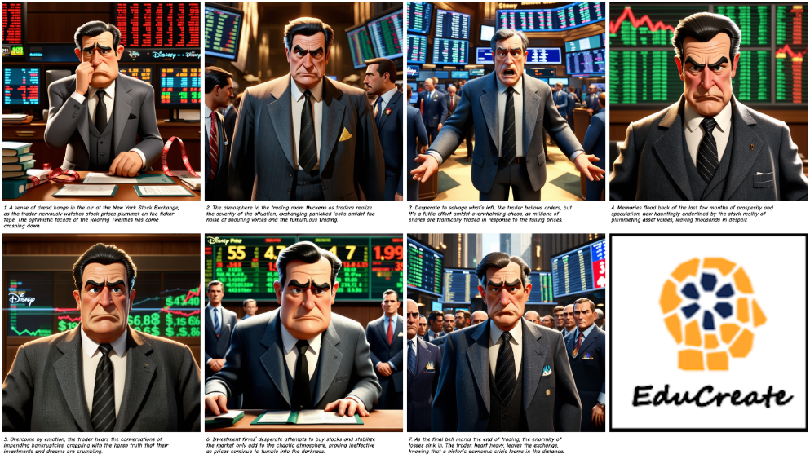
Stock Market Crash of 1929
User loads text data.
User Prompt: Write an account of the Stock Market Crash of 1929 from the perspective of a Wall Street trader working at the Wall Street Stock Exchange.
Comic Style: Disney Pixar

Slide 3
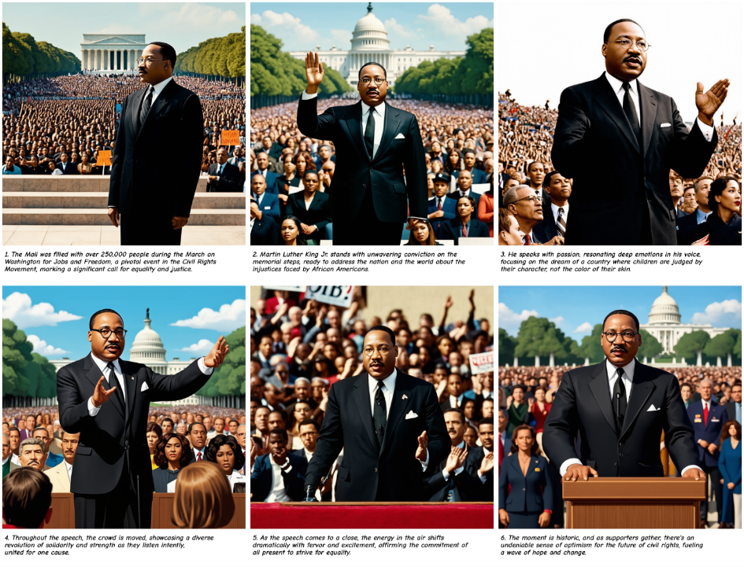
Civil Rights Movement
User utilizes EduCreate’s curated content.
User Prompt: Describe the Civil Rights Movement.
Comic Style: Disney Pixar

Slide 4
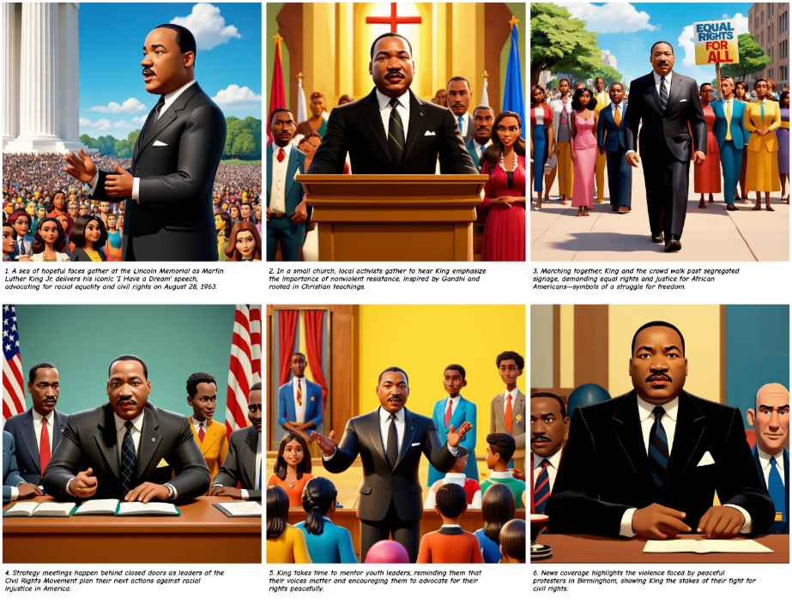
Civil Rights Movement
User utilizes EduCreate’s curated content.
User Prompt: Describe the Civil Rights Movement.
Comic Style: Disney Pixar

Slide 5
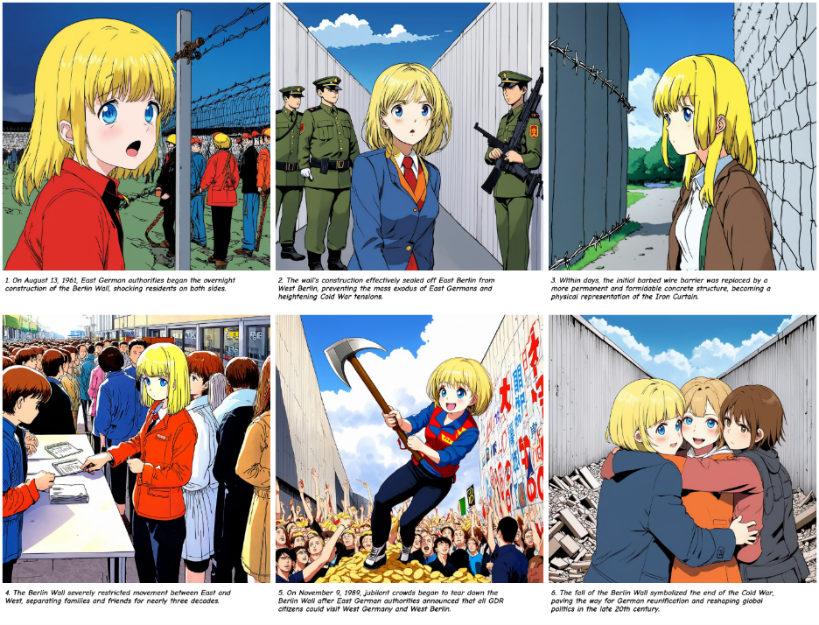
Berlin Wall
User utilizes EduCreate’s curated content.
User Prompt: Tell me about the Berlin Wall.
Comic Style: Japanese Anime

Slide 6
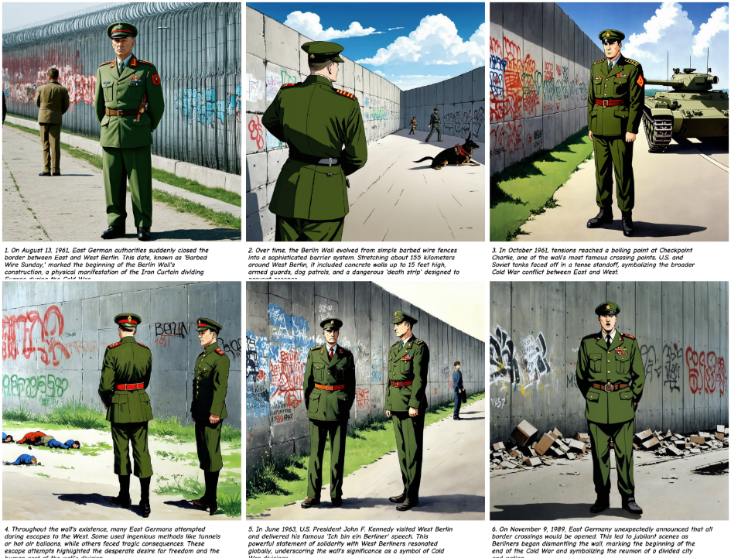
Berlin Wall
Additional context from user uploaded PDF.
User Prompt: Tell me about the Berlin wall.
Comic Style: Golden Age

Slide 7
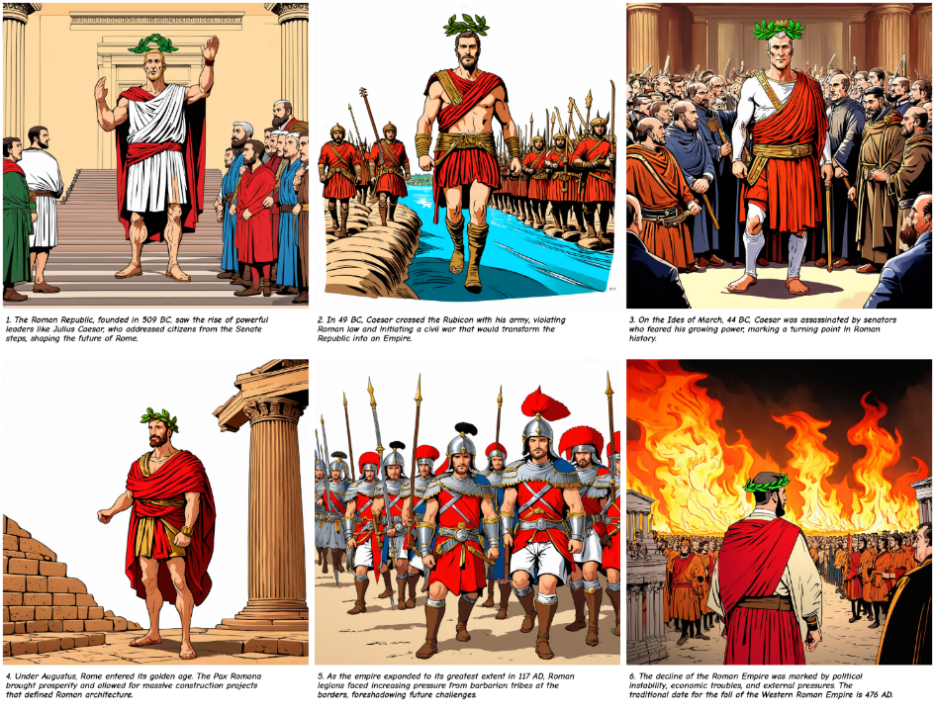
Rise and Fall of the Roman Empire
User utilizes EduCreate’s curated content.
User Prompt: Overview of the rise and fall of the Roman Empire.
Comic Style: Golden Age

Slide 8
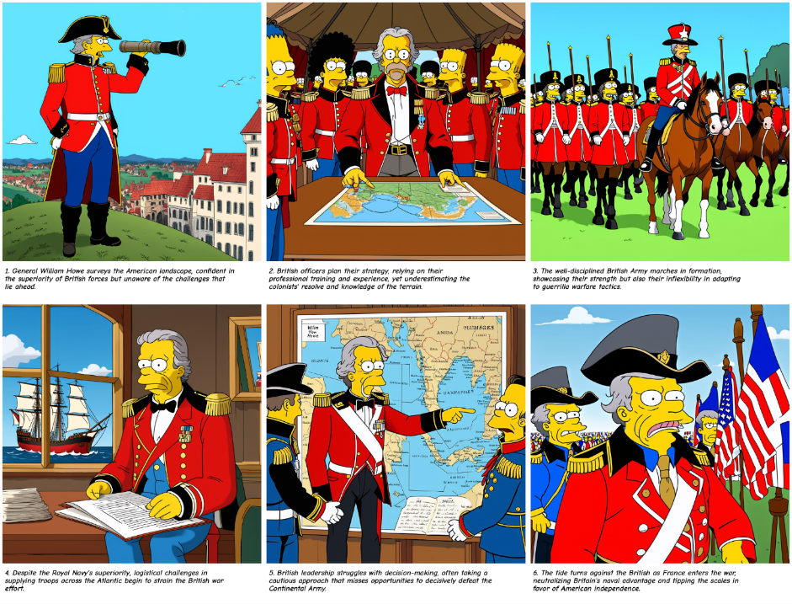
British Military in American Revolution
User utilizes EduCreate’s curated content.
User Prompt: Outline the strengths and weaknesses of British military during the American Revolutionary War.
Comic Style: Simpsons

Slide 9
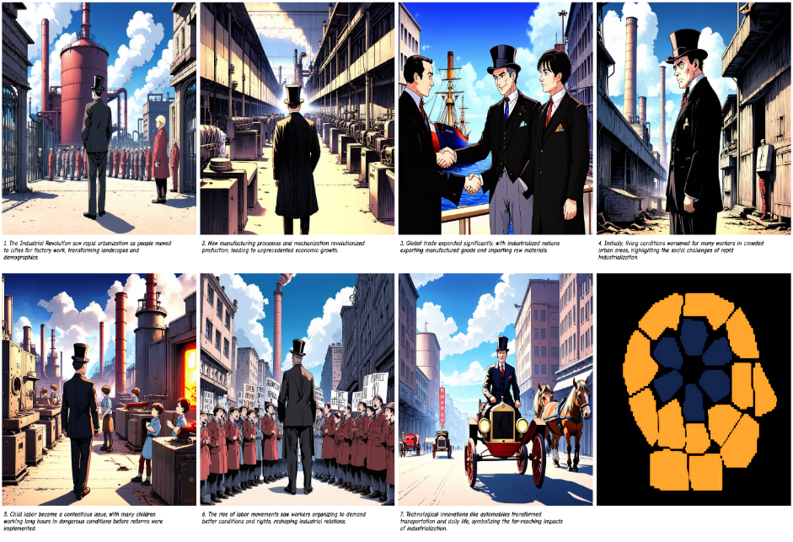
Industrial Revolution
User utilizes EduCreate’s curated content.
User Prompt: Help me teach a lesson on the global impact of the Industrial Revolution.
Comic Style: Japanese Anime

Slide 10
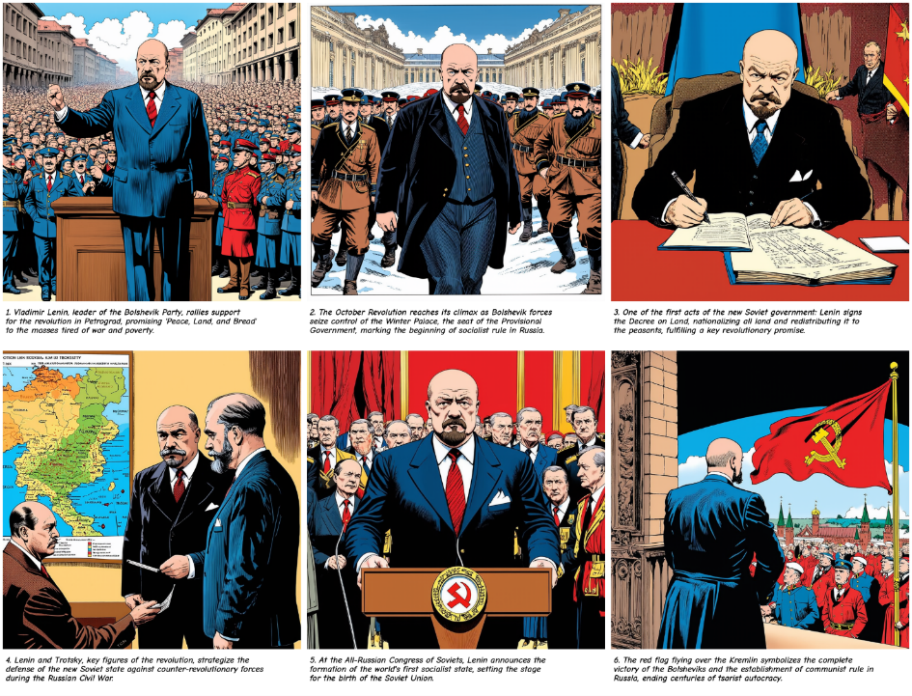
Russian Revolution
User utilizes EduCreate’s curated content.
User Prompt: Provide an introductory overview of the Russian Revolution between 1917 and 1923.
Comic Style: Golden Age

Slide 11
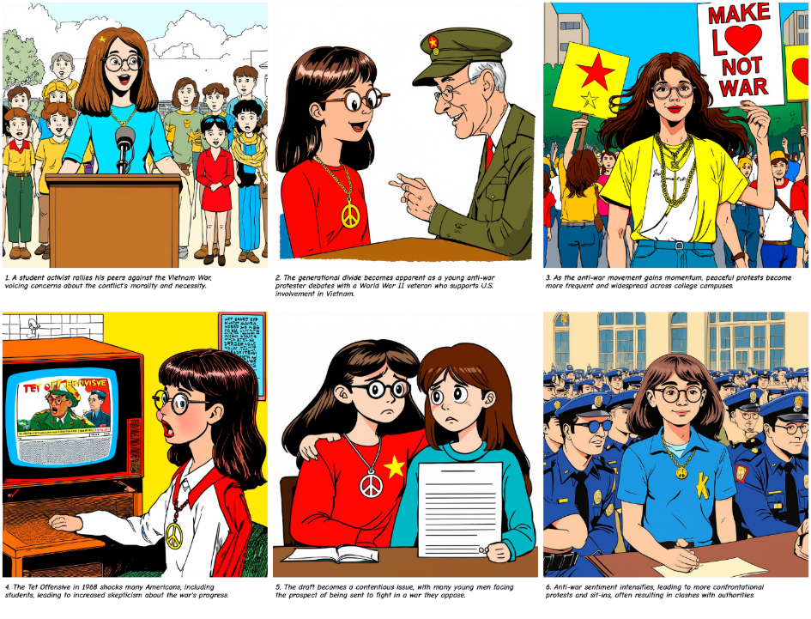
Vietnam War
User utilizes EduCreate’s curated content.
User Prompt: I want my class to learn about some of the different perspectives toward the Vietnam War.
Comic Style: Toon

Slide 12
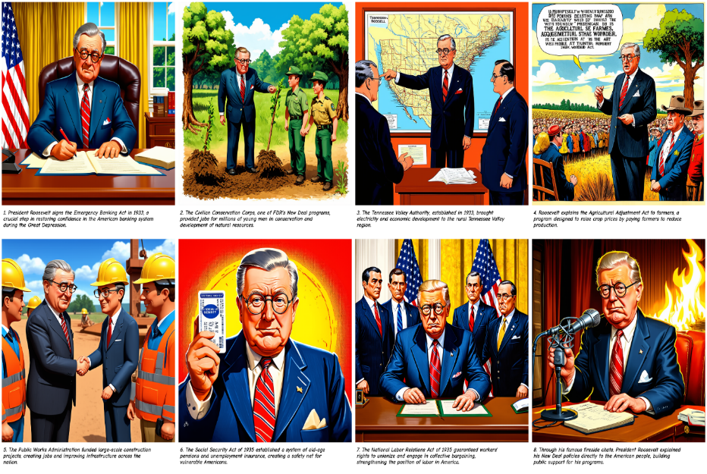
Great Depression and FDR
User utilizes EduCreate’s curated content.
User Prompt: Tell me about how President Franklin D. Roosevelt helped the U.S. emerge from the Great Depression.
Comic Style: Disney Pixar

Slide 13
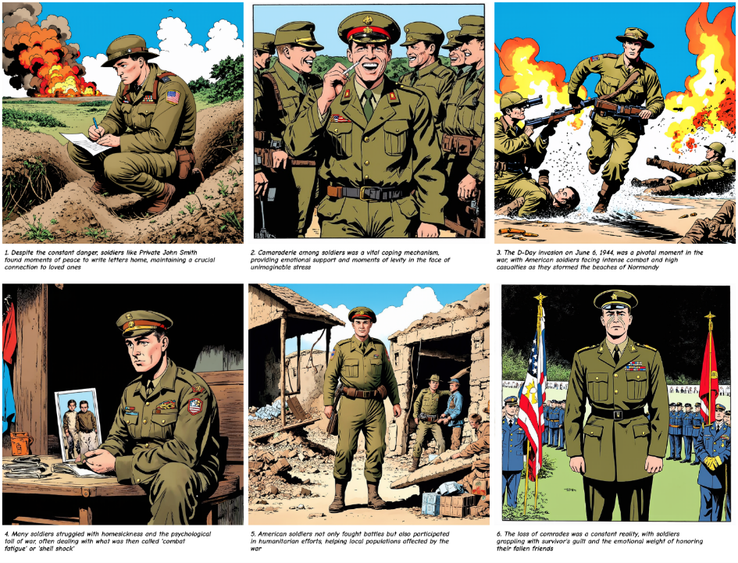
U.S. Soldier in WWII
User utilizes EduCreate’s curated content.
User Prompt: Tell me about World War II from a U.S. soldier's perspective.
Comic Style: Golden Age

Slide 14
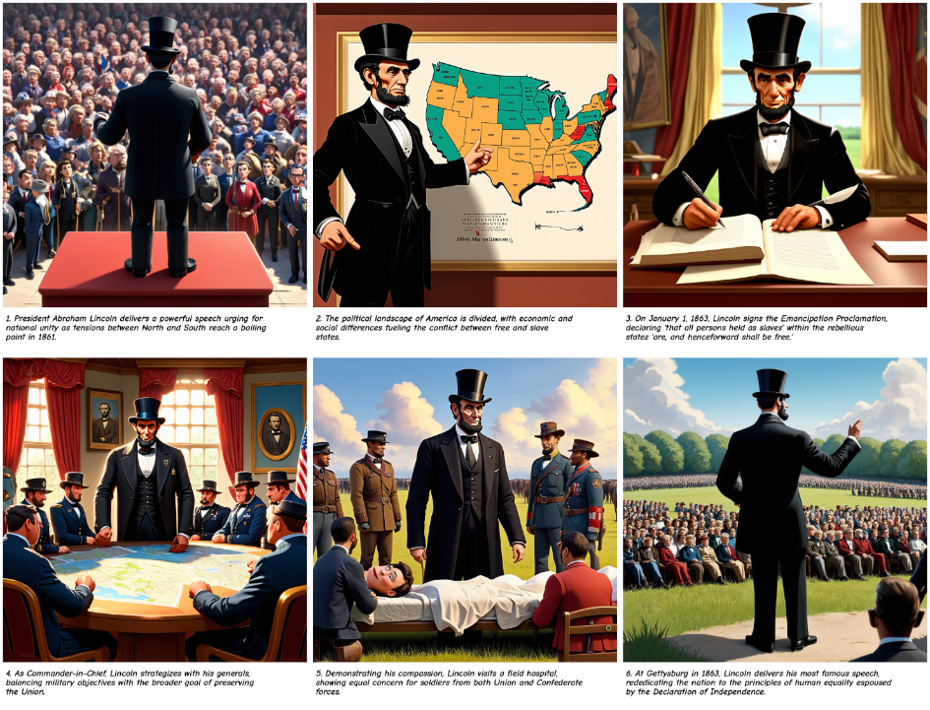
U.S. Civil War
User utilizes EduCreate’s curated content.
User Prompt: Describe the factors that led to the U.S. Civil War.
Comic Style: Disney Pixar

Slide 15
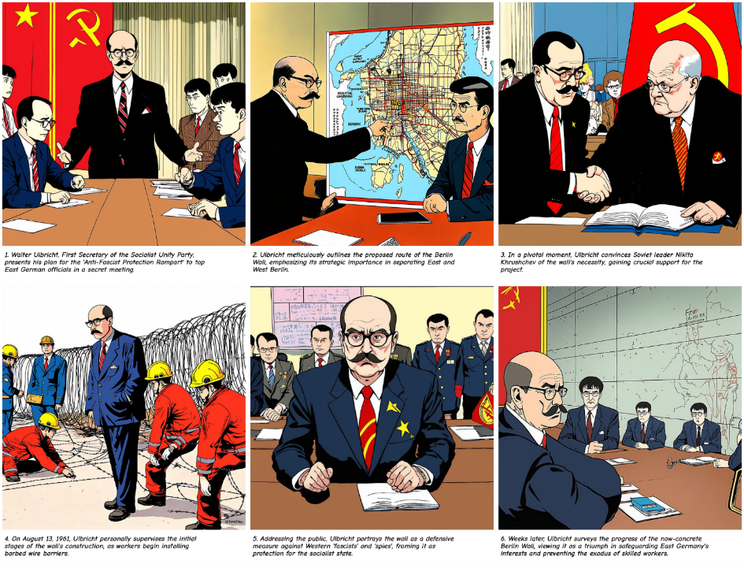
Berlin Wall Construction
User utilizes EduCreate’s curated content.
User Prompt: Explain the Berlin Wall from an East German perspective with an emphasis on the most significant individuals and their role in how the wall was constructed.
Comic Style: Japanese Anime

Slide 16
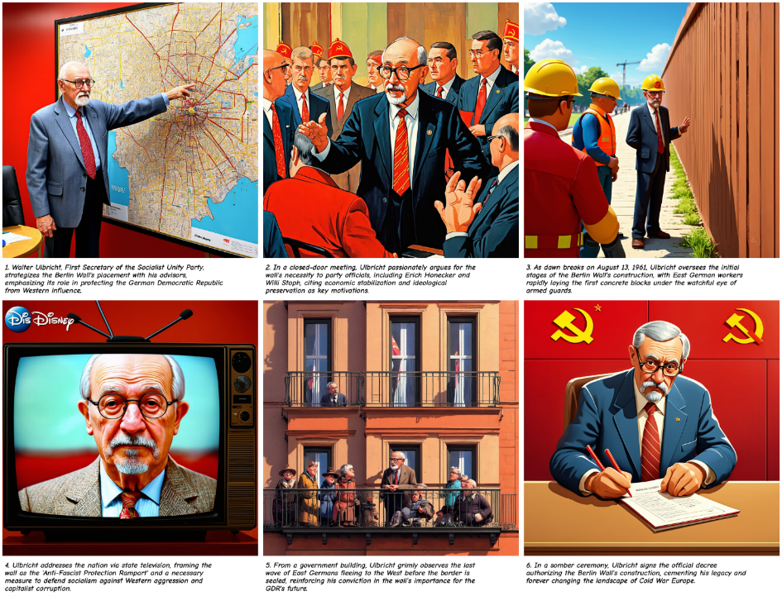
Berlin Wall Construction
User utilizes EduCreate’s curated content.
User Prompt: Explain the Berlin Wall from an East German perspective with an emphasis on the most significant individuals and their role in how the wall was constructed.
Comic Style: Disney Pixar

Slide 17
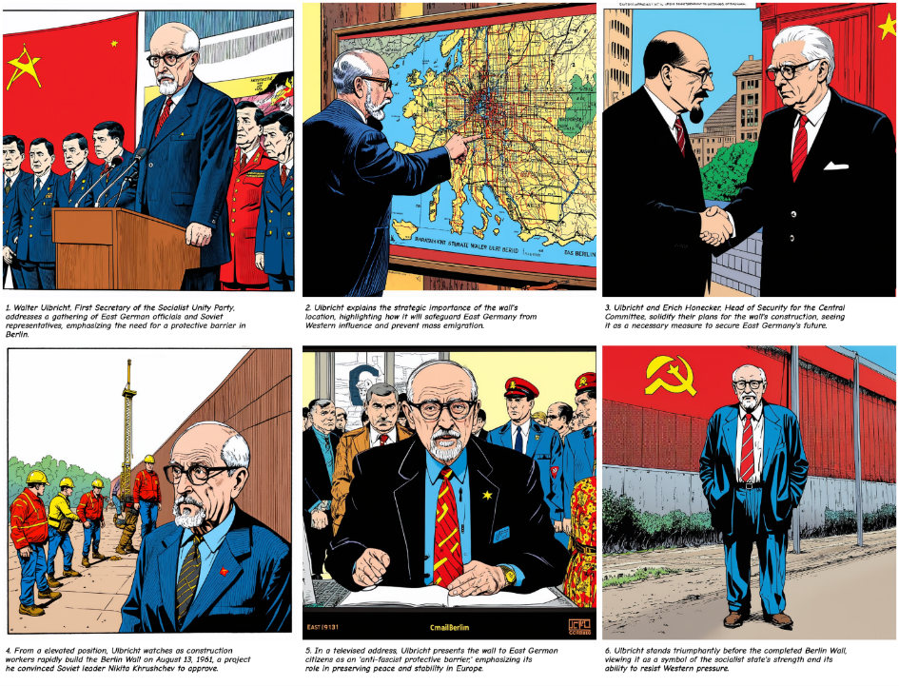
Berlin Wall Construction
User utilizes EduCreate’s curated content.
User Prompt: Explain the Berlin Wall from an East German perspective with an emphasis on the most significant individuals and their role in how the wall was constructed.
Comic Style: Golden Age

Slide 18
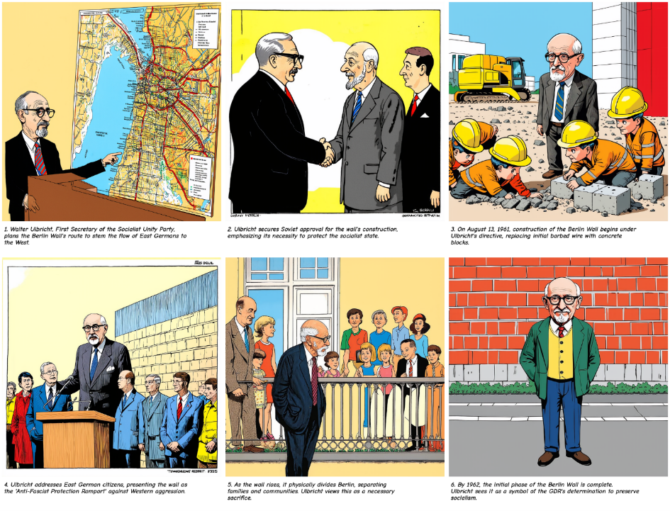
Berlin Wall Construction
User utilizes EduCreate’s curated content.
User Prompt: Explain the Berlin Wall from an East German perspective with an emphasis on the most significant individuals and their role in how the wall was constructed.
Comic Style: Toon

Slide 19
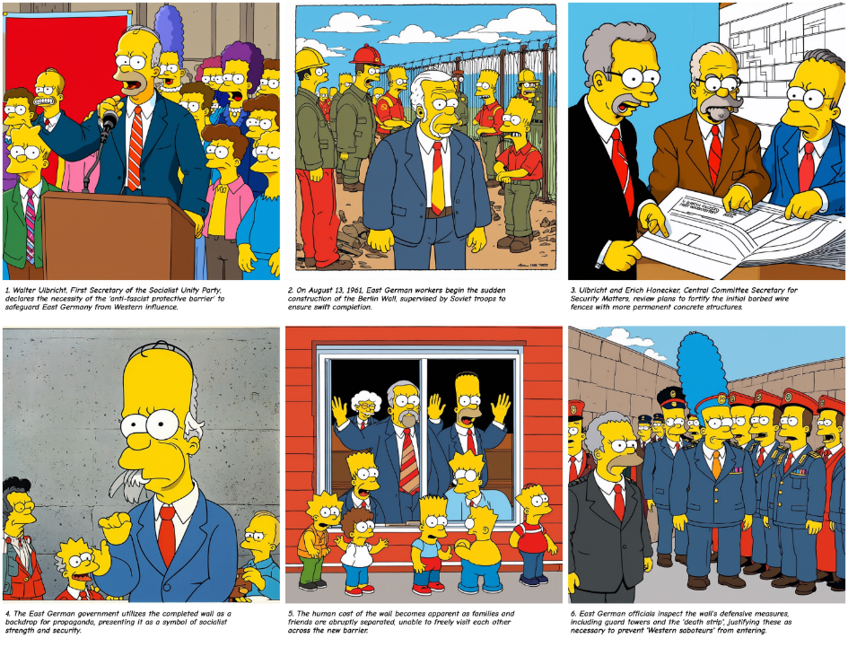
Berlin Wall Construction
User utilizes EduCreate’s curated content.
User Prompt: Explain the Berlin Wall from an East German perspective with an emphasis on the most significant individuals and their role in how the wall was constructed.
Comic Style: Simpsons

Slide 20
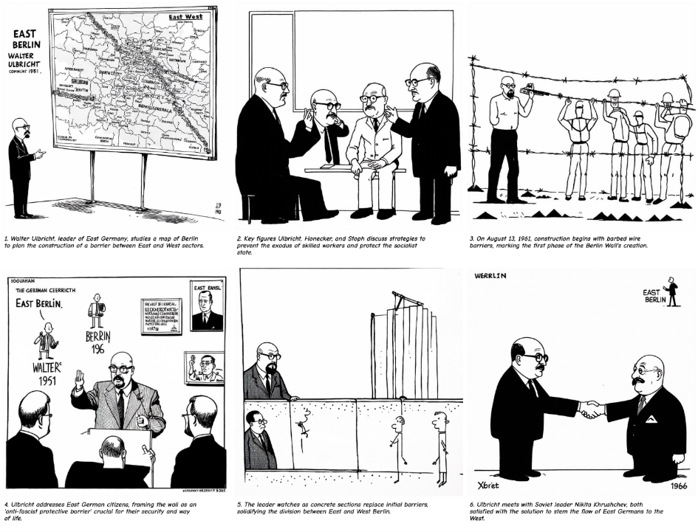
Berlin Wall Construction
User utilizes EduCreate’s curated content.
User Prompt: Explain the Berlin Wall from an East German perspective with an emphasis on the most significant individuals and their role in how the wall was constructed.
Comic Style: Stick Figure

Slide 21
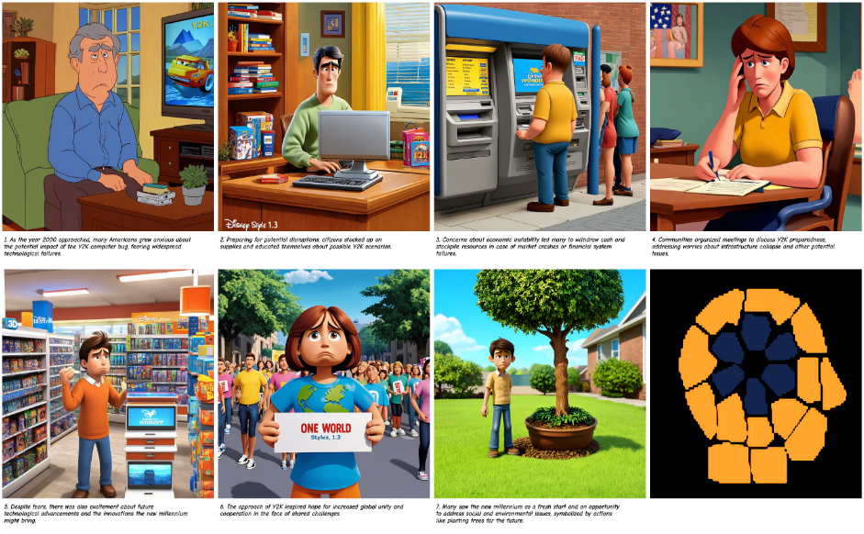
Y2K Hopes and Fears
User utilizes EduCreate’s curated content.
User Prompt: Explain some of the most significant fears and hopes that U.S. citizens had on the eve of January 1, 2000.
Comic Style: Disney Pixar

Slide 22
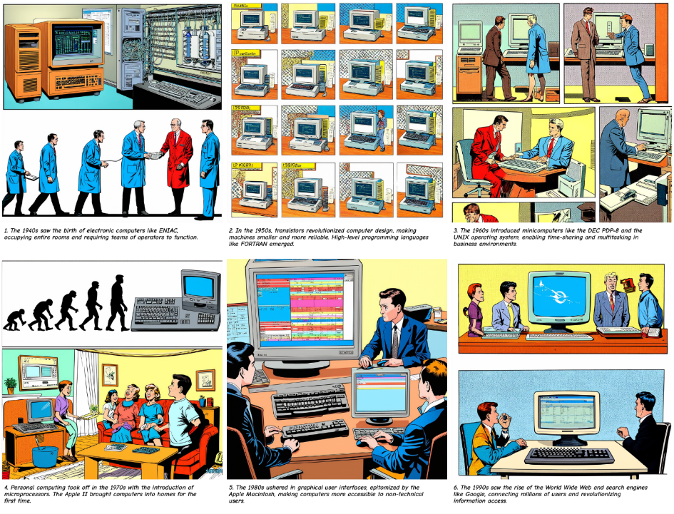
Evolution of Computer
User utilizes EduCreate’s curated content.
User Prompt: Explain how the computer was invented and how it evolved and advanced from its first days to where it was the end of the twentieth century.
Comic Style: Golden Age

Slide 23
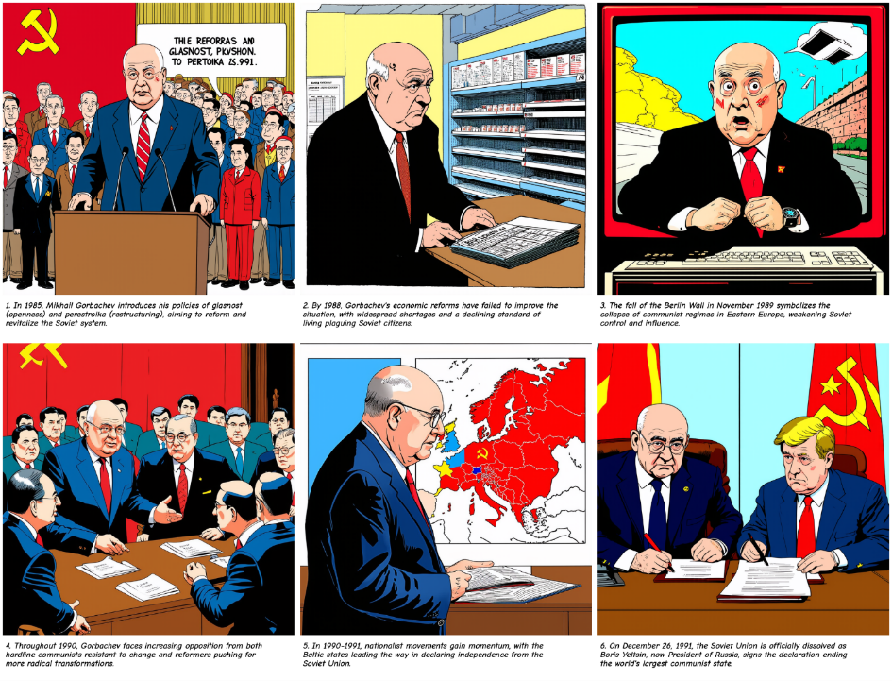
Breakup of the USSR
User utilizes EduCreate’s curated content.
User Prompt: Explain how the computer was invented and how it evolved and advanced from its first days to where it was the end of the twentieth century.
Comic Style: Toon

Slide 24
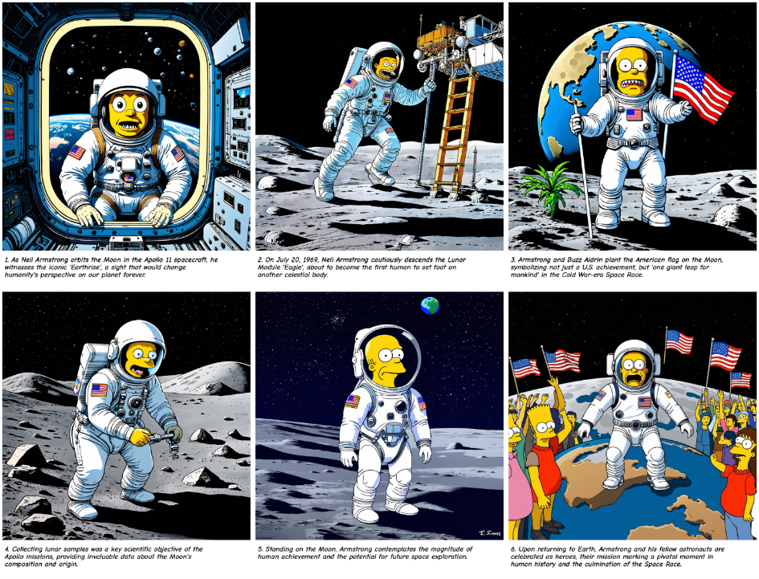
Space Race
User utilizes EduCreate’s curated content.
User Prompt: Explain the most significant events involved in the space race between the U.S. and the USSR (Soviet Union) during the twentieth century.
Comic Style: Simpsons

Slide 25
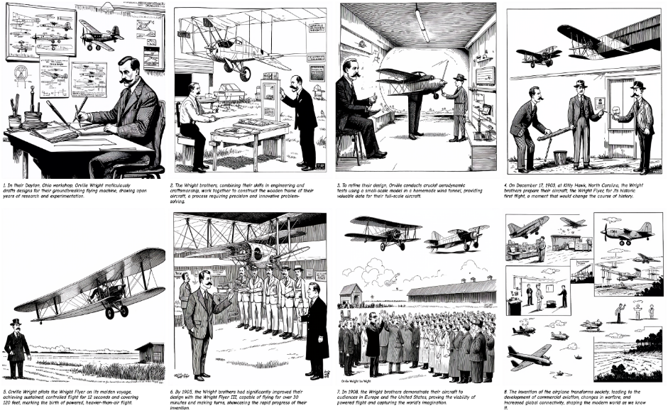
Invention of Airplane
User utilizes EduCreate’s curated content.
User Prompt: Give an overview of the invention of the airplane and why it was so important to society in the early twentieth century.
Comic Style: Stick Figure

Slide 26
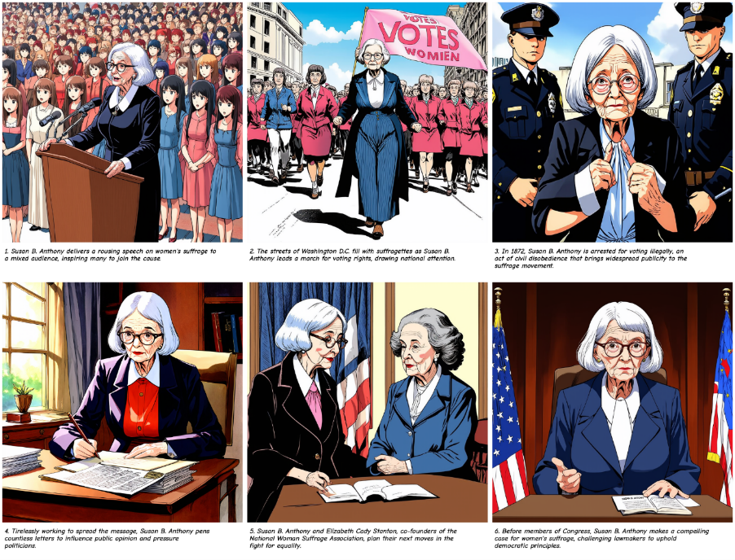
Women’s Suffrage Movement
User utilizes EduCreate’s curated content.
User Prompt: Provide a summary of the most significant people involved in the women's suffrage movement of the 1920s.
Comic Style: Japanese Anime

Slide 27
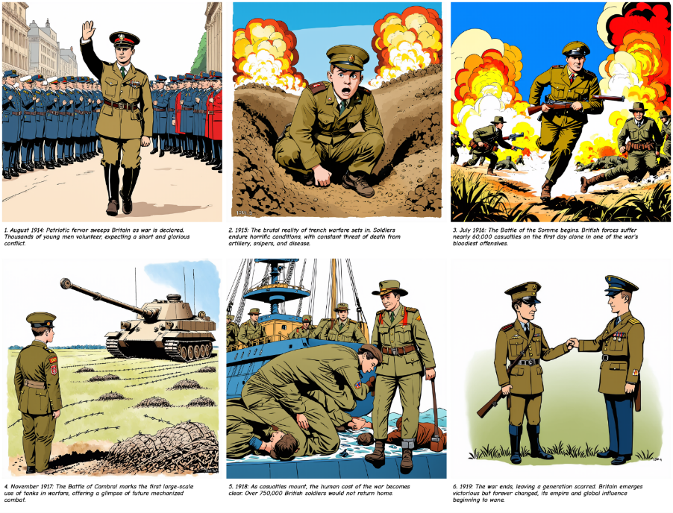
WWI from UK Perspective
User utilizes EduCreate’s curated content.
User Prompt: Describe some of the most significant events of World War I through the eyes of the United Kingdom.
Comic Style: Golden Age

Slide 28
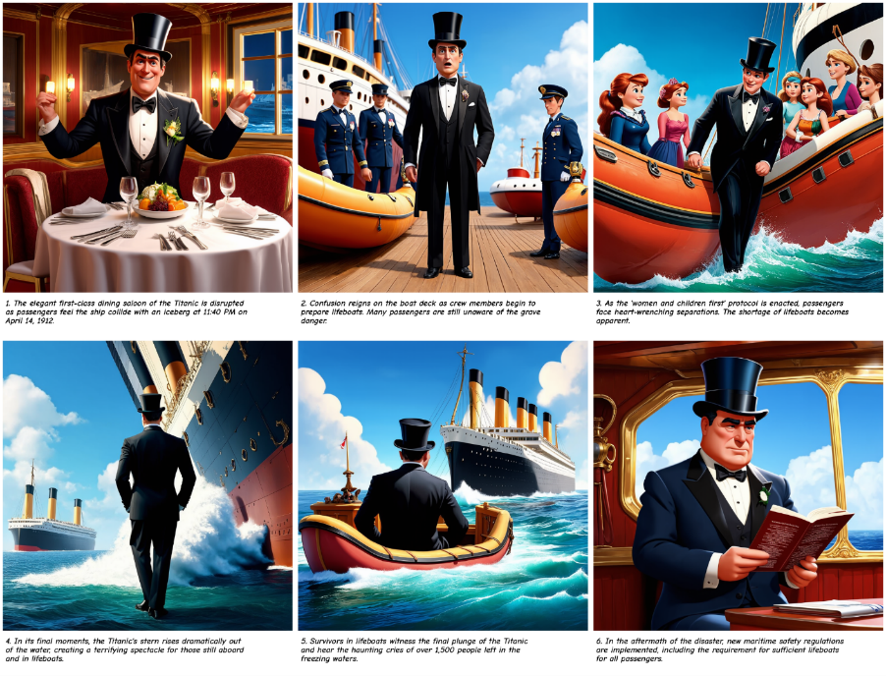
Titanic Shipwreck
User utilizes EduCreate’s curated content.
User Prompt: Explain the tragedy of the Titanic and why it was significant to society from the perspective of a passenger.
Comic Style: Disney Pixar

Slide 29
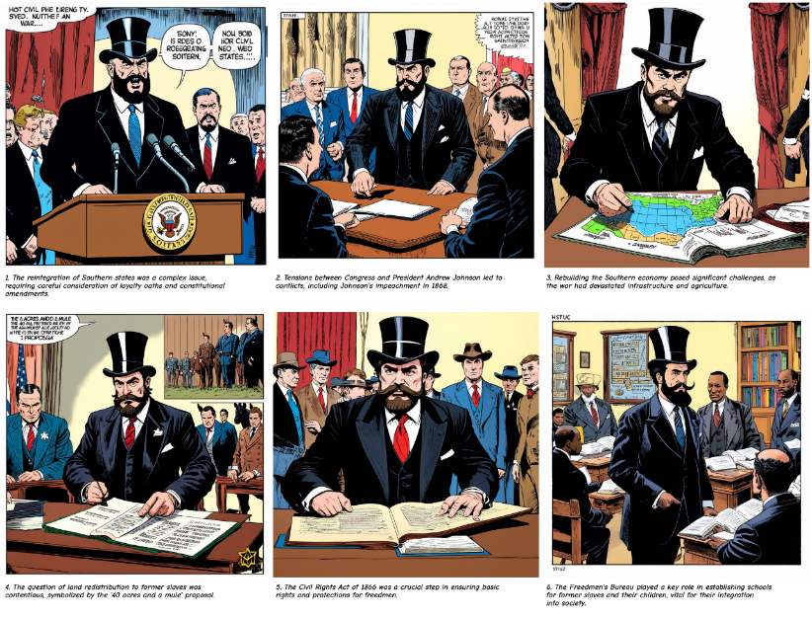
Post-Civil War U.S. Reconstruction
User utilizes EduCreate’s curated content.
User Prompt: Summarize the main factors the U.S. government had to consider in the post-Civil War Reconstruction era from the perspective of a U.S. Congressman.
Comic Style: Golden Age

Slide 30
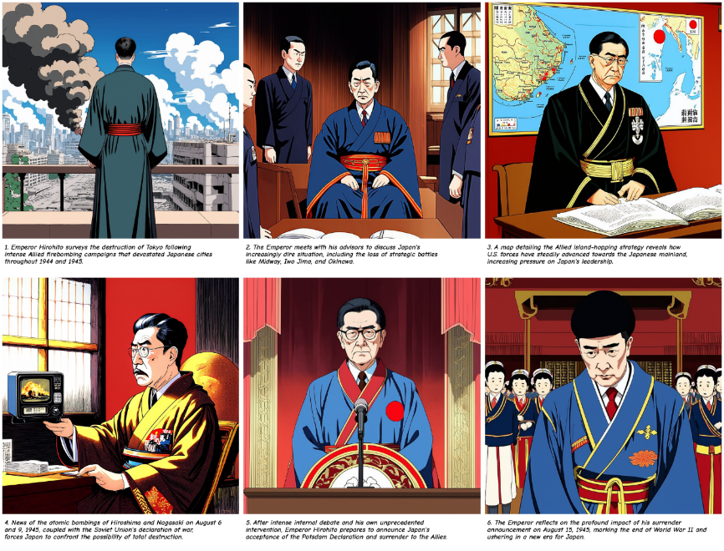
Japanese Surrender WWII
User utilizes EduCreate’s curated content.
User Prompt: Tell me about the major events leading to the Japanese surrender in World War II.
Comic Style: Japanese Anime

